Slide 1
Search
We’ve got all the students here at this university and we want to find information about one of the students.
How do we do it?
Linked List?
Binary Search Tree?
AVL Tree?
Binary Heap?
Array?
We want something better...

Slide 2
Hashing:
Let’s go back to arrays:
If we know the index of where the student occurs in the array, we can access the student info in 1
e.g., the student’s id num
We need a way to MAP the student (or other data) to an index in the array
Mapping:
a way of taking a key and mapping it to an index (a number)
Hashing function maps the key to an index

Slide 3
Mapping
We’ve got 5000 students, each with a student id that’s 5 digits long.
Why not use the student ids as the index?
Can you think of a better way to map the student to an index?
How big should the array be?
What problems might we hit?

Slide 4
Hash Function:
A good hash function:
Maps all keys to indices within an array
Distributes keys evenly within array
Avoids collisions
Is fast to compute

Slide 5
Potential Hash functions:
Could just take the key (which somehow can be represented as a number) and then mod with arraysize
E.g., student.id % arraySize
Problem:
Could end up with many numbers hashing to the same value
E.g., array is 100 and keys are all multiples of 10

Slide 6
Hash Functions
Goal: to take x keys and map each key to a different index in an x-element array
This is a perfect hashing function
If we cannot define a perfect hashing function, we must deal with collisions.
When more than one key maps to the same index
We need to worry about:
Hashing function
Array Size
How we handle collisions

Slide 7
Improving Hash Functions: Array Size
We know that we’re probably not going to be able to fill the array perfectly (we’ll have some unfilled spaces)
So let’s pick the size of the array
Make it a prime number
works better with larger primes that aren’t close to powers of 2)
E.g., 8 random numbers between 0 and 100, hash function is number%11:
x: 71 y: 5
x: 81 y: 4
x: 75 y: 9
x: 89 y: 1
x: 29 y: 7
x: 99 y: 0
x: 79 y: 2
x: 72 y: 6
0 | 1 | 2 | 3 | 4 | 5 | 6 | 7 | 8 | 9 | 10
99 | 89 | 79 |  | 81 | 71 | 72 | 29 |  | 75

Slide 8
Example Hash Function (for numbers)
An example of a hash function:
Multiply the key by some constant c between 0 and 1
k*c
Take the fractional part of k*c (the stuff that gets cut out when you floor a number)
(k*c) – floor(k*c)
Multiply that by a number
m * ((k*c) – floor(k*c))
Take the floor of that
h(k) = floor(m * ((k*c) – floor(k*c)))
A good value for c is: (sqrt(5) – 1)/2
(got that?)

Slide 9
Hash Functions:
There are many hashing functions
You can come up with your own…
Remember:
Quick to calculate
Evenly distributes keys within a range
Consistently map a key to an index

Slide 10
Potential Hash Functions: Strings
A simple function to map strings to integers:
Add up character ASCII values (0-255) to produce integer keys
E.g., “abcd” = 97+98+99+100 = 394
==> h(“abcd”) = 394 % ArraySize
Calculations are quick
Depend on length of string
Potential problems:
Anagrams will map to the same index
h(“listen”) == h(“silent”)
Small strings may not use all of array
h(“a”) < 255
h(“I”) < 255
h(“be”) < 510
If our array is 3000, the hash function will skew the indexing towards the beginning of the array

Slide 11
Hashing of Strings (2.0):
Treat first 3 characters of string as base-27 integer (26 letters plus space)
Key = (S[0] + (27¹ * S[1]) + (27² * S[2])) % ArrayLength
You could pick some other number than 27…
Which problem does this address?
Calculated quickly (good!)
Problem with this approach:
It’s better, but there are an awful lot of words in the English language that start with the same first 3 letters:
record, recreation, receipt, reckless, recitation…
preclude,preference, predecessor, preen, previous...
Destitute, destroy, desire, designate, desperate…

Slide 12
Hashing with strings (3.0)
Use all N characters of string as an N-digit base-b number
Choose b to be prime number larger than number of different characters
i.e., b = 29, 31, 37
len = string.length
for i = 0; i < len; i++ {
h += string[len-i-1] * pow(37,i);
}
h= h%ArrayLength;
Code:
int main() {
string strarr[10]={"release","quirk","craving","cuckold","estuary","vitrify",
"logship","vase","bowl","cat"};
string maparr[17];
for (int i = 0; i < 10; i++) {
int h = 0;
int L = strarr[i].length();
for (int j = 0; j < L; j++) {
h += ((int)strarr[i][L-j-1])*pow(37,j);
}
h %= 17;
maparr[h] = strarr[i];
}
return(0);
}

Slide 13
Hashing function:
Base: 37
Array length: 17
Problems:
longer calculations, especially for longer words:
Even with this hashing function we have a collision!
string | release | quirk | craving | cuckold | estuary | vitrify | logship | vase | bowl | cat
value | 3351469349 | 217854664 | 107039122 | 318270269 | 1048416211 | 1022511193 | 1526799914 | 6114203 | 5120464 | 139236
value%17 | 14 | 4 | 16 | 9 | 7 | 4 | 11 | 0 | 13 | 6
0 | 1 | 2 | 3 | 4 | 5 | 6 | 7 | 8 | 9 | 10 | 11 | 12 | 13 | 14 | 15 | 16
vase |  |  |  | vitrify |  | cat | estuary |  | cuckold |  | logship |  | bowl | release |  | craving

Slide 14
Collisions
When multiple keys map to the same array index.
There’s a trade-off between the number of collisions and the size of the array:
Huge arrays should mean fewer collisions
Load factor:
number of indices (n)/total number of slots (m)
Indicates how full the array is
But with a reasonable array size, we will have collisions, no matter how good our hashing function is…

Slide 15
Handling Collisions:
There are many ways to handle collisions
Chaining
linear probing
quadratic probing
random probing
double hashing
etc.

Slide 16
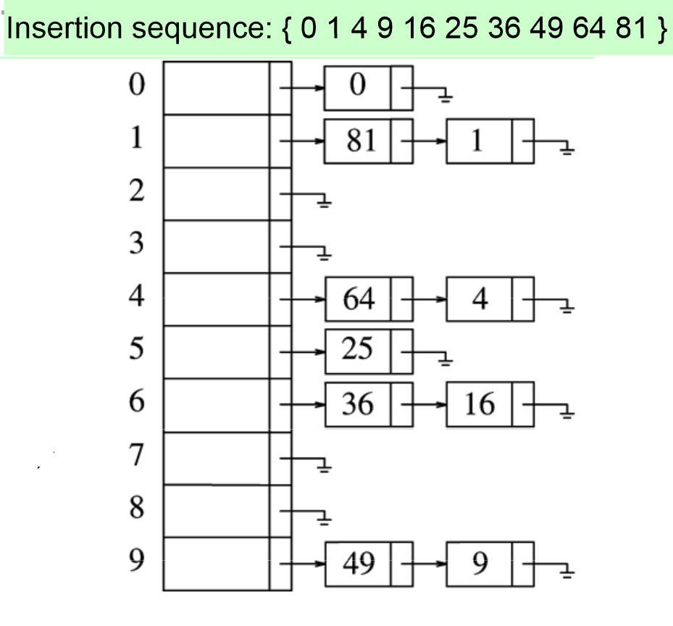
Collisions: Chaining
Two keys hash to the same index
We could store them both in the same index
Make each entry in the array be a pointer to a linked list
(You thought we’d escaped pointers for a while, huh).
HashArray is an array of linked lists
Insert element either at the head
Or at the tail
The key is stored in the list at arr[h(k)]
e.g., arraySize = 10
H(k) = k % 10
Insert: 0, 1, 4, 9, 16, 25, 36, 49, 64, 81
Note: we shouldn’t pick 10 as an array size –
it was used for easy demonstration

Slide 17
Chaining:
Worst case, how long to:
Insert?
Delete?
Search?

Slide 18
Chaining downfalls:
Linked lists could get long
Especially when number of keys approaches number of slots in array
A bit more memory because of pointers
Must allocate and deallocate memory (slower)
Absolute worst-case :
All N elements in one linked list!
Bad hash function!

Slide 19
Open Addressing:
Store all elements in the Hash Array
so no pointers to linked list
When a collision occurs, look for another empty slot
Probe for another empty slot in a systematic way
Why systematic?
We will most likely need a larger Array than for chaining
Why?

Slide 20
Open Addressing: Linear Probing
Hash the key to an index.
If the index is full, look at the next slot
If that is full, look at the next slot
Continue until a slot in the array is empty
Insert key in the empty slot
If hit the end of the array, loop back to beginning
Effectiveness?
Insert?
Delete?
Search?

Slide 21
Problems:
Clustering
Keys tend to cluster in one part of the array
Keys that hash into the cluster will be placed at the end of the cluster
Making the cluster even larger
Could add 1, then add 2 to that, then add 3 to that, etc.
E.g., h(k0) = 3
Check 3, then 4, then 6, then 9, then 13, etc.
Helps some if keys are clustered in the same area
Doesn’t help as much if many keys result in the same index
Over time, probing takes longer

Slide 22
Open Addressing: Quadratic Probing
Another way of dealing with collisions:
h_{i}(k) = (h(k) + i²) % ArraySize
So probe sequence would be:
h(k) + 0, then +1, then +4, then +9, then +16, etc.
Example:
h₀(58) = (h(58) + 0²) % 10 = 8 (X)
h₁(58) = (h(58) + 1²) % 10 = 9 (X)
h₂(58) = (h(58) + 2²) % 10 = 2 (X)
h₃(58) = (h(58) + 3²) % 10 = 7
This helps to avoid the clustering right around the collision (even more spread out)
Doesn’t help a lot when many keys hash to the same index in the hash array

Slide 23
Next: Pseudo-random probing
Ideally, when a collision happens, the next index selected would be randomly chosen from the unvisited slots in the array
Can’t select the next index randomly
Why not?
Instead, pseudo-random probing
Use the same sequence of random numbers
For the ith slot in the probe sequence,
H(k) + r(i) where r(i) is the ith value in the random permutation of numbers from to the length of the array
All insertions and searches use the same sequence of random numbers

Slide 24
Pseudo-random probing
So for instance:
Random number sequence:
h₀(33) = (33 + rs[0])%10 =3
h₀(43) = (43 + rs[0])%10 =3 X
h₁(43) = (43 +rs[1])%10 = 1
h₀(51) = (51 + rs[0])%10 = 1X
h₁(51) = (51 + rs[1])%10 = 9
h₀(53) = (53 + rs[0])%10 = 3 X
h₁(53) = (53 + rs[1])%10 = 1 X
h₂(53) = (53 + rs[2])%10 = 6
Calculations: quick!
Helps with clustering (when keys cluster to the same area in the hash table (array))
Doesn’t really help with when many keys cluster to the same index
0 | 1 | 2 | 3 | 4 | 5 | 6 | 7 | 8 | 9
0 | 8 | 3 | 4 | 7 | 2 | 9 | 6 | 1 | 5

Slide 25
Double Hashing:
Problem: if more than one key hashes to the same index, with linear probing, quadratic probing, and even random probing, the probes follow the same pattern
The sequence of probing after that first hash is based on the index, not on the original key
Fix:
Double-hashing
If collision, probe at:
p(k,i) = h(k) + i*h₂(k)
Example: h2(k) = 1+(k mod(m))
Make m be a prime number less than the size of the array

Slide 26
Example of double-hashing
E.g., arraysize = 11, m = 7
h2(k) = i+(k mod(m-1))
h2(k) = i+(k mod(m)
h₀(55) = 55%11 = 0
h₀(66) = 66%11 = 0 X
H2((66) =(1+k%(M))) = 1 + (66%7) = 4
P2(66) = 0 + 1*4 = 4%11 = 4
h₀(11) = 11%11 = 0 X
H2(11) = 1+k%(M))) = 1 + (11%7) =5
P2(11) = 0 + 1*5 = 5%11 = 5
h₀(88) = 88%11 = 0X
H2(88) = 1+k%(M))) = 1 + (88%7) =5
P2(88) = 0 + 1*5 = 5%11 = 5X
P3(88) = 0 + 2*5 = 10%11 = 10
Note: why do we need to add 1 to the h2 function?

Slide 27
Deletion with Probing:
What if we delete a value?
Would this cause a problem?
Quick and Dirty Solution:
When you delete, mark the slot as “deleted” somehow
Different from an empty slot
So when probing during a search, continue to search past “deleted” slots until either the value is found or a slot is empty
Note: The array must have an empty value (and hopefully a bunch of empty values)
Why?
Problem: could have a hash array with very few values, yet search could take a while
May need “compaction”
Sort of like “defragging”
Remove all values from the hash array and rehash

Slide 28
Back to inserting:
What is the best case for insertion?
What is the worst case for insertion?
When does this happen?
Clearly the more we avoid collisions, the more efficient hashing is
Usually, the more elements in the hash array, the more collisions
Back to load of hash array
Rule-of-thumb – we don’t want the hash array to get more than 70% full
When a hash table(array) is more than 70% full, we want to:
Allocate a new array
Size at least double the previous array’s size
Take all the values and rehash
Modifying the hashing function so that it maps to all possible values in the new array
Time: 0(n)
Ugh!

Slide 29
Hash Tables:
Good for:
data that can handle random access
data that requires a lot of searching for data
Not so good for:
Data that must be ordered
Finding the largest, smallest, median value, etc.
Dynamic data
A lot of adding and deleting of data
Data that doesn’t have a lot of unique keys

